Slide 1

ATCLL MOBILE
Milestone 4 – Final Presentation
Project in Computer and Informatics Engineering – (LECI), Department of Electronics, Telecommunications and Informatics, University of Aveiro
Alexandre Gago – 98123​
Ana Rosa – 98678​
Bernardo Kaluza – 97521​
Filipe Silveira – 97981
Nuno Cunha – 98124​
Pedro Lima – 97860​
Supervisors:​
Dr.a Susana Sargento​
Dr. Pedro Rito​
Dr. Miguel Luís

Slide 2
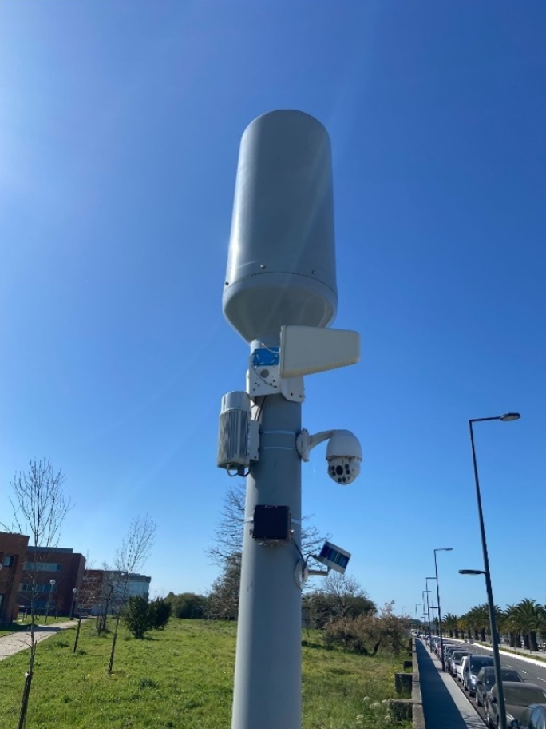
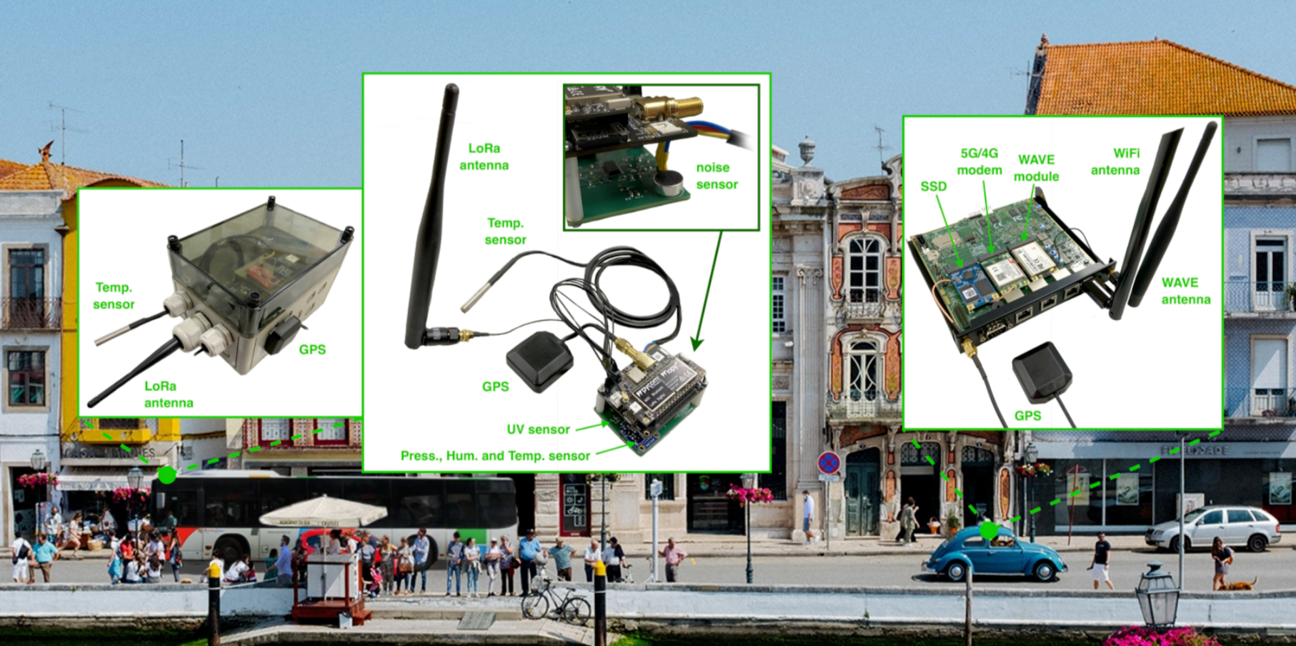
Context
The Aveiro Tech City Living Lab (ATCLL) is composed of an advanced communications infrastructure and an urban data management platform in the city of Aveiro.
Aveiro therefore contains several stations composed of various communication technologies installed in Smart Lamp Posts and buildings in the city. It also contains environmental sensors, mobility sensors (e.g., radars, LIDARs, video cameras).

Slide 3
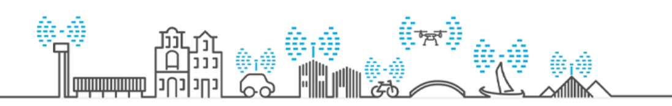
Problem
Enrich the Aveiro Tech City Living Lab (ATCLL) infrastructure in order to improve the lifestyle of citizens.
The people in the city of Aveiro that use public transports have to rely on the static schedules and these schedules usually don't account for the delays. We can use our infrastructure to provide better schedule results, through prediction of the buses arrival.
The streets of the city sometimes have a lot of traffic at key times of the day, we can use the radars of the infrastructure to inform the citizens of such traffic as a warning to avoid those streets.

Slide 4
Objectives
Bus tracking and arrival prediction
Through the application it is possible to track the positions of buses in real time and its line, as well as the prediction of the time of arrival at the stops of the line.
Live Traffic
Using the information provided by the radars, the application makes a traffic evaluation through a color system, and allows a visualization of the average speed of the vehicles on the roads.

Slide 5
Methodology
Line Detection, Prediction, Live Traffic
UI
Server
Interface that allows the users to visualise the produced data
Server hosted in IT that stores and sends data to the app
Responsible to produce the needed data to the app

Slide 6

Architecture
MQTT (Message Queue Telemetry Transport)
MQTT is a protocol that communicates data over low-bandwidth, unreliable networks. The protocol uses a publish/subscribe mechanism to exchange messages. The broker is the one that receives and sends the messages received from the publishers to the subscribers.

Slide 7

Architecture
ORION
Orion is a service that allows to collect information from various types of data (e.g. Traffic) and services (e.g. Transdev). The information is collected either historically or in real time through a URL to provide the type of data and the service required.

Slide 8
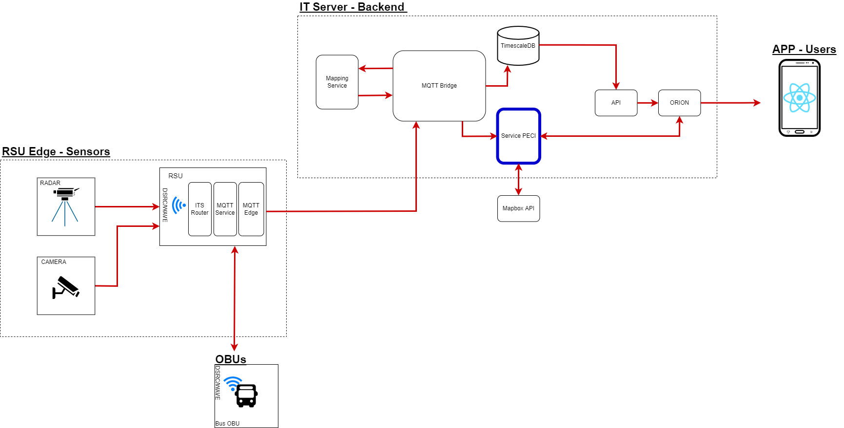
Architecture

Slide 9
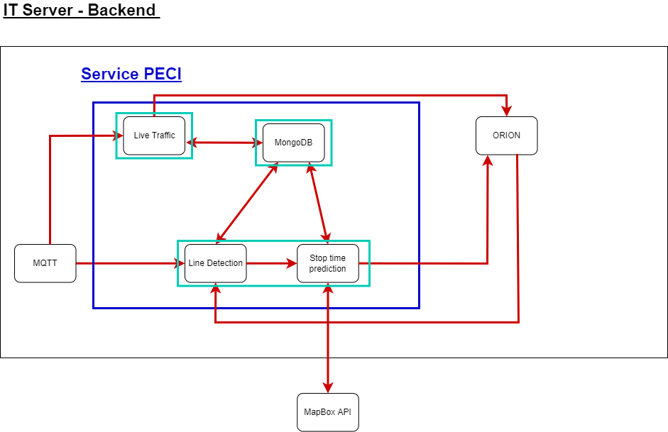
Architecture

Slide 10
Architecture
Communication with the App
To communicate with the app, we had to create 2 topics in the orion API to differentiate our data with the main IT’s server data.
These were:
bus_line
aveiro_livetraffic

Slide 11
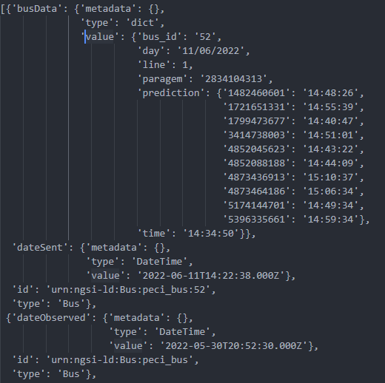
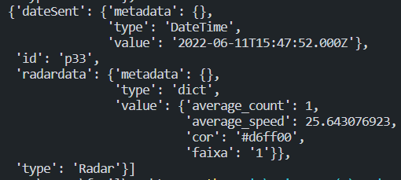
Architecture
Communication with the App
Bus_line
Aveiro_livetraffic

Slide 12
Server

Slide 13
Server
Features:
Use of Orion to obtain location (latitude and longitude) and ID of OBU (On Board Unit) of each bus from historical data in IT’s database.
Use of MQTT to get bus information in real-time.
Communication between the app and IT’s server using ORION.
Host of a MongoDB database used to store data produced by the algorithms.
Notes:
EXPLAIN MQQT AND ORION

Slide 14
Server
Problem | Solution
ORION broker documentation not up to date and/or not functional. | Update of documentation by the group in IT.
The current and UTC timezone from the ORION timestamps did not match. | Before processing the data, the timezone was changed for each timestamp value in order to match Lisbon timezone.
The historical data in the ORION broker was not being updated correctly to the cloud. | This is being addressed in IT.
When receiving the MQTT data from buses, multiple messages were received when the bus was in radar range. | A filter was implemented, so that line detection starts only when the first bus enters the radar range.

Slide 15
Line Detection

Slide 16
Line Detection
Features:
Information about lines and bus stops stored in JSON format.
Confidence based algorithm that, given the positions of a bus in the previous hour, returns its possible line.
Estimated time of Arrival prediction for the next stops of each bus in real time using the MapBox API.
Store the algorithm’s output in a Mongo Database so the data collected can be used in future work.
The line detection service is running in a docker container continuously in a IT server.
Notes:
Quanto á line detection,
Foi implementado um algoritmo de deteçao de linha de um autocarro baseado num fator de confiança;
Foi implementado um tempo estimado de chegada de um autocarro as suas seguintes paragens com ajuda do MapBox API
Foi criada uma base de dados mongo para guardar os dados produzidos pela line detection;
Todos os serviços foram postos a correr dentro de docker containers dentro de um servidor do IT.

Slide 17
Line Detection
Problem | Solution
Old Code base non functional | Make our own line detection algorithm and Estimated time of Arrival
Although each bus has an identifier, each bus changes its line multiple times a day | The algorithm filters the received data of each bus
History data is not reliable | Adapt the line detection algorithm to be confidence-based
Some lines are nested inside others | Group those lines and treat them as one
Notes:
Vamos agora falar de alguns problemas que tivemos resumidamente:
Cada autocarro muda de linha varias vezes por dia, o que nos obrigou a filtrar os dados recebidos pelo orion
O historico das posiçoes do autocarro por vezes nao tem dados suficientes o que nos obrigou a fazer um algoritmo baseado em confiança

Slide 18
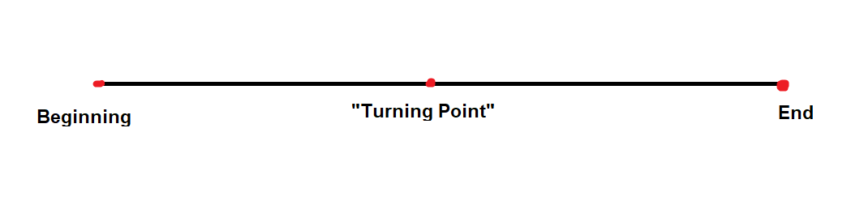
Line Detection
Problems found:
To calculate the ETA the direction of the bus had to be determined.
Solution:
We filtered the History data in search of a stop that could assign the direction of the bus.
If no such stop is found, count the number of times the current stop of the bus appears in the line, if it is only once there’s no need to determine the direction.
Notes:
Outro problema que tivemos foi determinar a direçao de um autocarro para calcular onde ele está na ida ou vinda da linha;
Para resolver isto procuramos no historico por paragens de inicio ou meio de linhas.

Slide 19
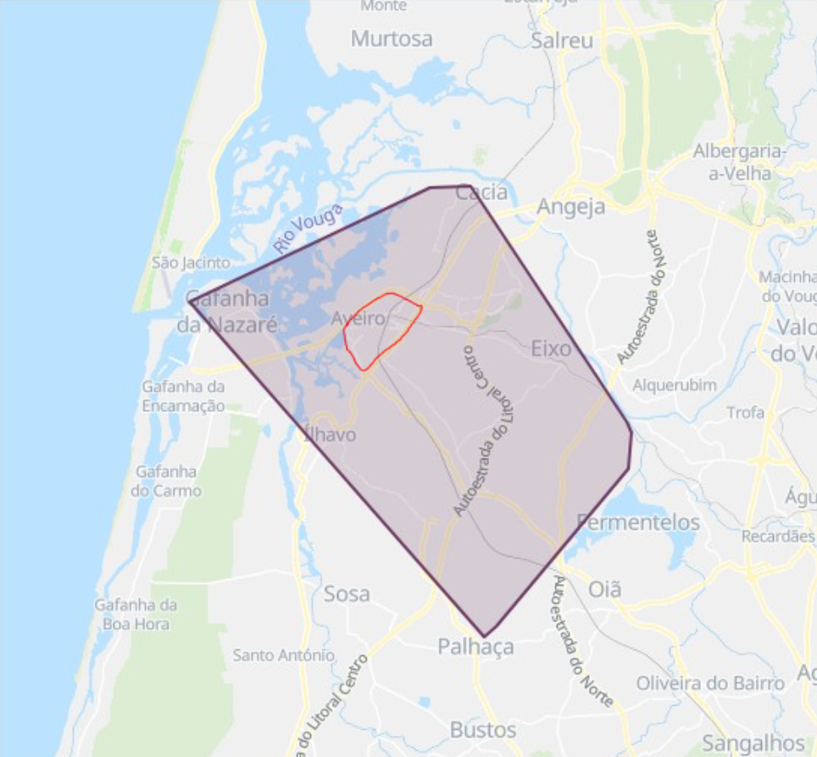
Line Detection
Problems found:
The coverage of the Smart Lamp posts and Murals is small compared to the coverage of the Aveiro Bus’s lines. Furthermore most of the posts and Murals are in the middle of the city in which the bus lines merge and the same stop can belong to various different lines.
Solution:
We had to get the history of the last hour of the bus to determine its lines because outside of the city the lines diverge and isolate themselves.

Slide 20
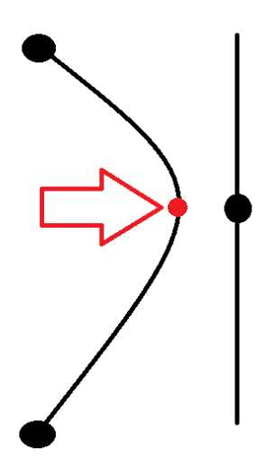
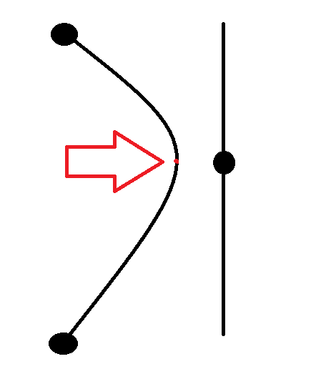
Line Detection
Problems found:
There are some stops that only belong to one line so we associated that line to the bus. However in situations like the one on the image, the algorithm would associate an incorrect line to the bus.
Solution:
We implemented a confidence system to choose the most probable line and assign it to the bus.

Slide 21
Live Traffic

Slide 22
Live Traffic
Features:
Process real-time radar data and compare it to the average of the previous day.
Allocate a color to the processed data, this color is posted in Orion to be retrieved by the App
Mongo Database storing the traffic data each day so data can be used in future projects.

Slide 23
UI

Slide 24

UI
Framework used - React Native
Features:
Main map updated with the buses.
Lines menu showing stops of line with estimated time of arrival and respective bus in a map.
Receiving data from main IT server and our own server and generating access token.
Bus schedule menu.
Live traffic map.
About page.

Slide 25
UI
Problem | Solution
Problem with receiving the data and saving it, even though the request was being made. | We used javascript Promises so that we would only store data when the Promise confirmed the arrival of data.
Due to the amount of requests done, the app would get progressively slower in certain screens. | We switch the places where the requests were made to reduce extra unwanted requests.
Some of the component libraries we tried to use had problems during installation or didn’t work as intended. | We researched various libraries and we also made backups with relative frequency to ensure the app stayed stable.

Slide 26
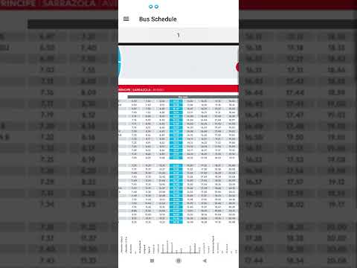
DEMO

Slide 27
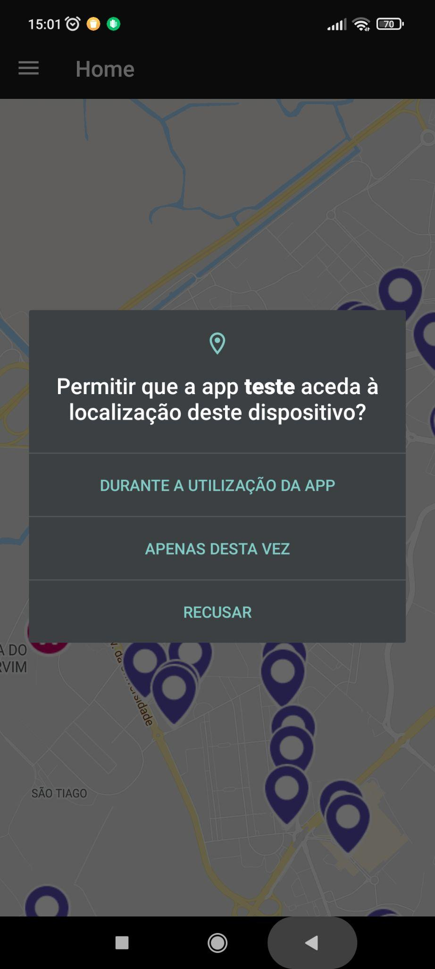
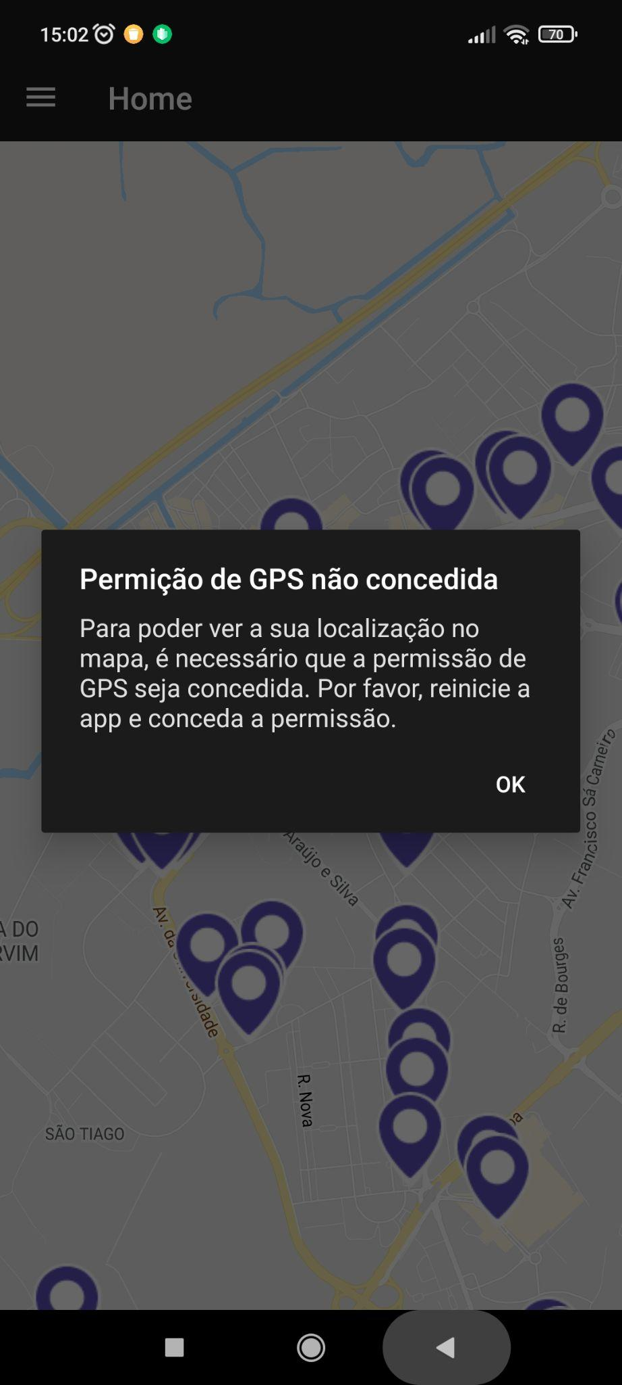
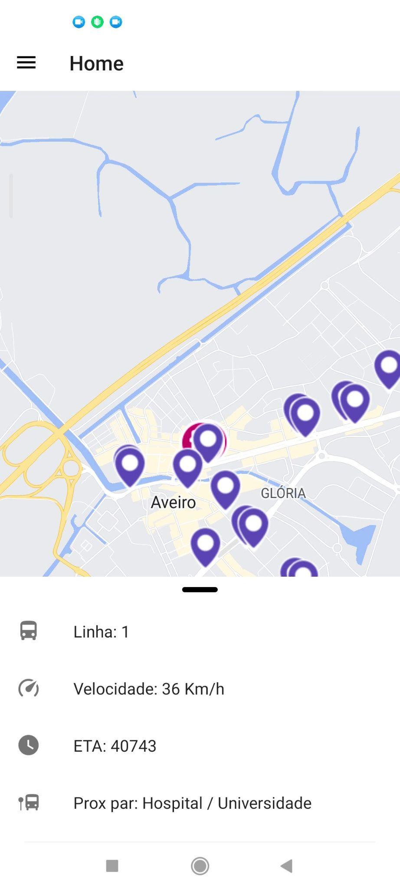
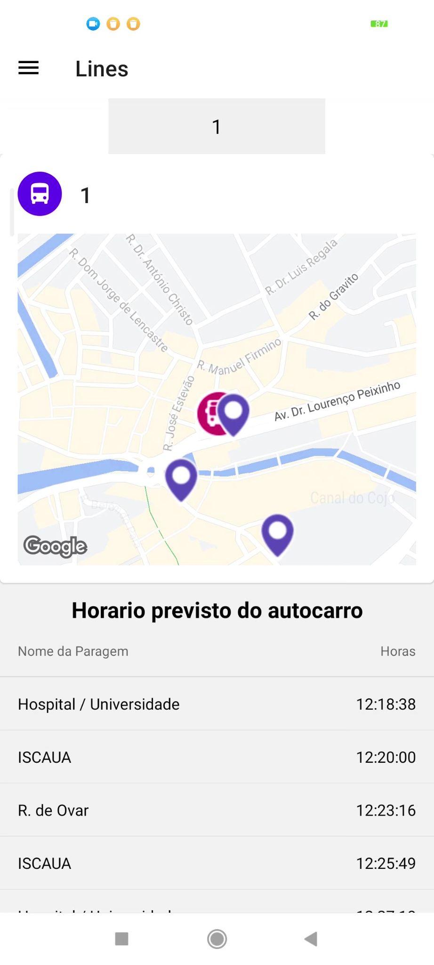
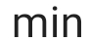
DEMO

Slide 28
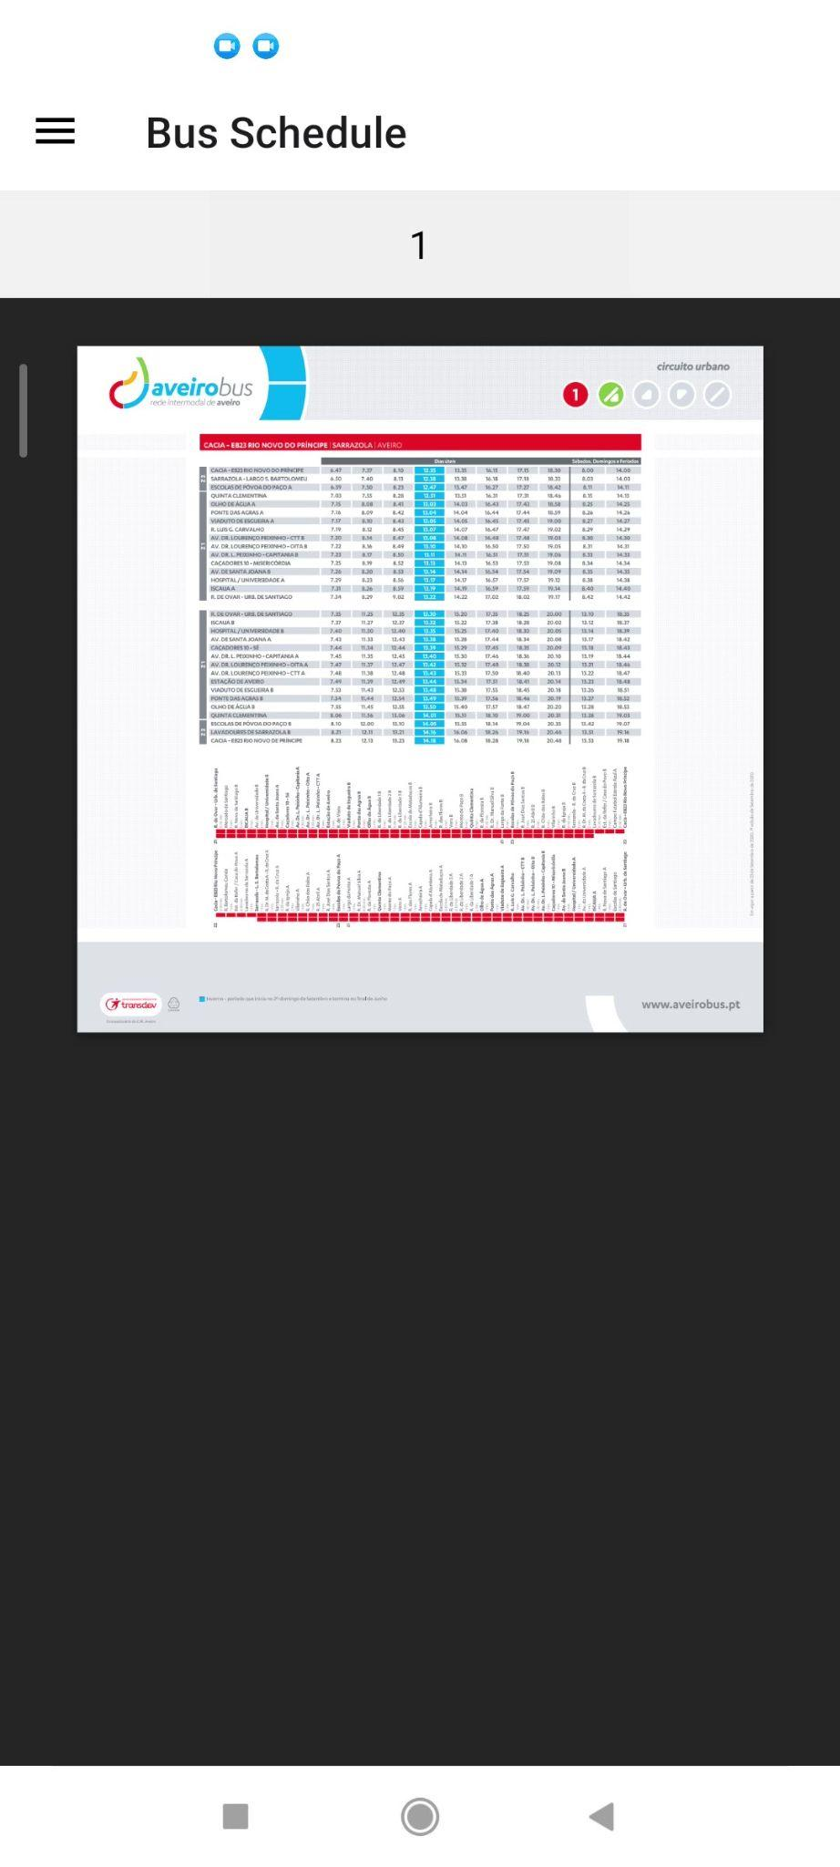
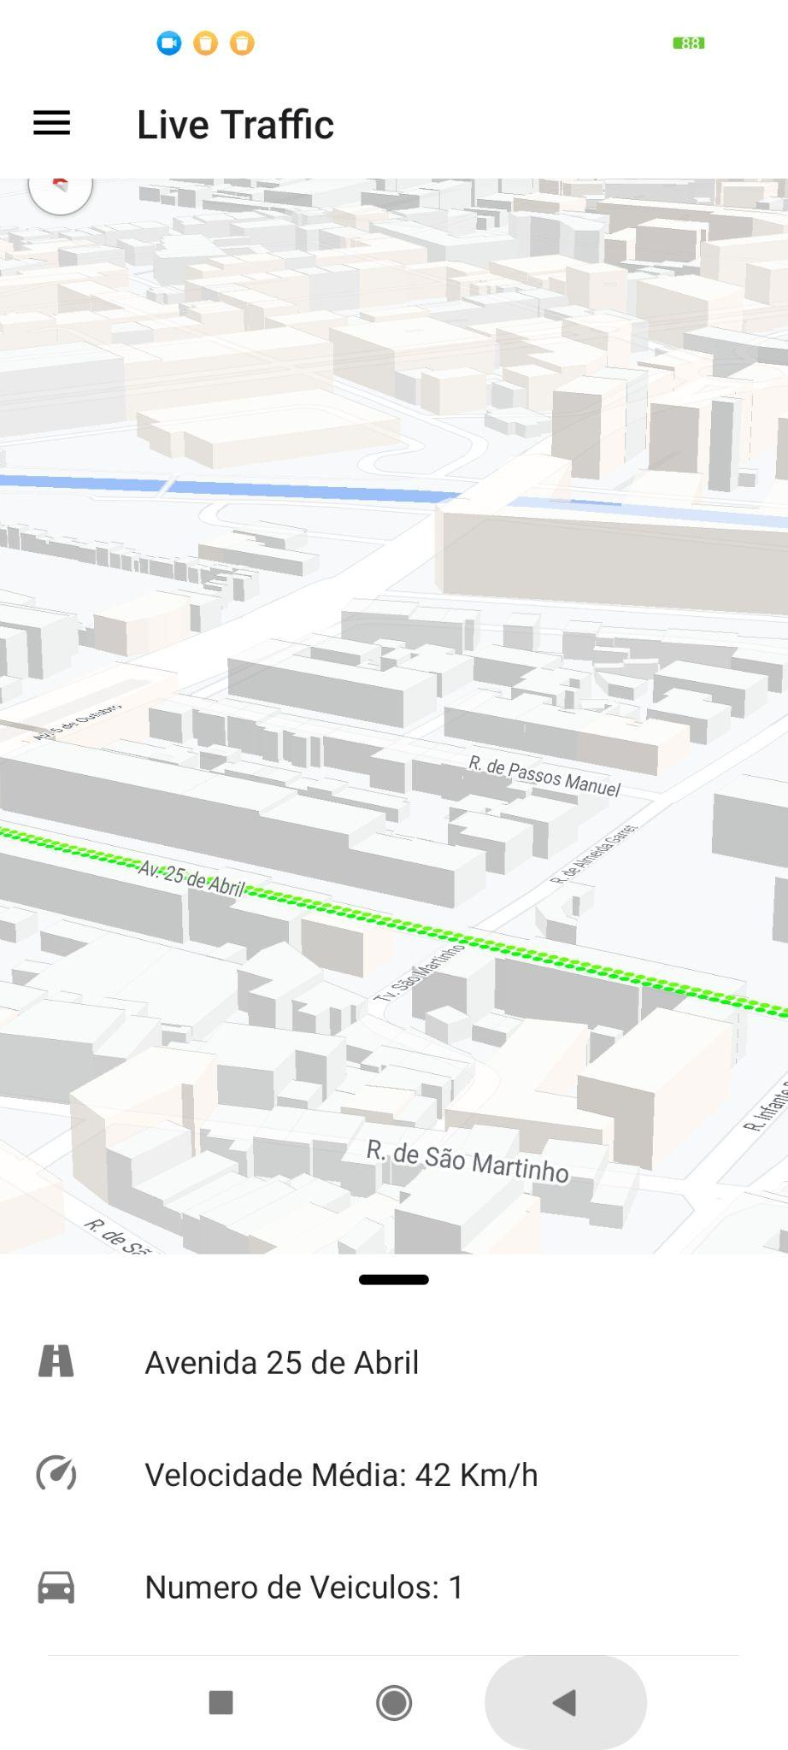
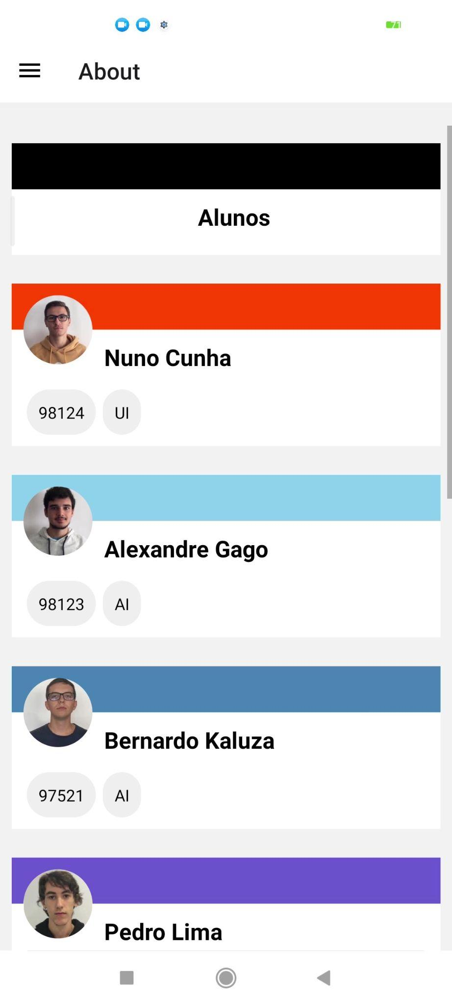
DEMO

Slide 29
Results Discussion
We were able to achieve our two main objectives, which include the Bus tracking and arrival prediction and the Live traffic, thus adding new features to the ATCLL infrastructure already implemented and deployed.

Slide 30
Vision for the future
How the product will be used:
This will be used though an smartphone Android/IOS app by any citizen of the city of Aveiro that uses buses as his main way of transportation or that wants to know the current traffic of the city
What can be improved:
The line detection, in the future, will be an API provided by Transdev
For the Line Detection, in the future we will have more active smart lamp posts; therefore, our prediction will be improved and there's always room to improve the prediction algorithm
The live traffic feature will also be improved with the installation of more radars, but contrary to the other features, this one must be done through an update of the app.

